Slide 1


Agro Data Cube Exploration
Data Science Team
22/10/18

Slide 2
Outline
Sprint 1:
Exploring Architecture & Programming Languages
Exploring Organization of the Data Cube

Slide 3
Exploring Architecture and Programming Languages of the Agro Data Cube
The data warehouse was built with Java 8 programming language.
Postgres 9.2 database was used in the development.
NetBeans IDE 8.0.2 was also used in the development.
The Python programming language would be used to extract information from the database via the API.

Slide 4
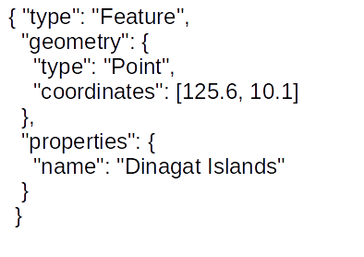

Exploring Architecture and Programming Languages of the Agro Data Cube
The API returns information in GeoJSON format.
GeoJSON is a format for encoding a variety of geographic data structures.

Slide 5
Exploring Organization of the Data Cube contd.
There are a number of get requests made available through the API to access data in the cube.
These have been organized into the following folders based on the kind of information they help to retrieve:
AHN (Actueel Hoogtebestand Nederland) - It provides data on zonal statistics for land altitude.

Slide 6
Exploring Organization of the Data Cube contd.
Codes - provides data about crops and soils based on their unique codes.
Field - provides information about fields such as the geometry (area), soil information, crop information, altitude zonal statistics, Normalized Difference Vegetation Index (NDVI) and nearest meteostations.
(meteostations are weather stations, ie. facilities, either on land or sea, with instruments and equipment for measuring atmospheric conditions to provide information for weather forecasts and to study the weather and climate.)

Slide 7
Exploring Organization of the Data Cube contd.
MeteoData - provides weather data for the various meteostations in the database based on dates.
MeteoStations - provides data about meteostations in the database.
Regions - provides boundary information about provinces, postal code areas and municipalities in the Netherlands based on 2015 data.

Slide 8
Exploring Organization of the Data Cube contd.
SoilParams (Soil Parameters) - provides information about the constituents of a kind of soil.
SoilTypes - provides information on the different soil types found in the Netherlands.

Slide 9
Exploring Organization of the Data Cube contd.
Sources – This is supposed to provide metadata about the content of the Agro Data Cube but does not do so at the moment. According to the team at Agro Data Cube, this function is deprecated and if we need any specific information on anything, they would be ready to provide it.

Slide 10
End of Sprint 1

